Slide 1

Lecture 2
Ali Bazarah
MIS 300-1

Slide 2
Learning Objectives
2.1 What major features of a business are important for understanding the role of information systems?
2.2 How do systems serve different management groups in a business, and how do systems that link the enterprise improve organizational performance?
2.3 Why are systems for collaboration and social business so important, and what technologies do they use?
2.4 What is the role of the information systems function in a business?

Slide 3
1- Organizing a Business: Basic Business Functions (1 of 2)
Business: formal organization that makes products or provides a service in order to make a profit
Four basic business functions
Manufacturing and production
Sales and marketing
Finance and accounting
Human resources

Slide 4
Organizing a Business: Basic Business Functions (2 of 2)
Five basic business entities
Suppliers
Customers
Employees
Invoices/payments
Products and services

Slide 5
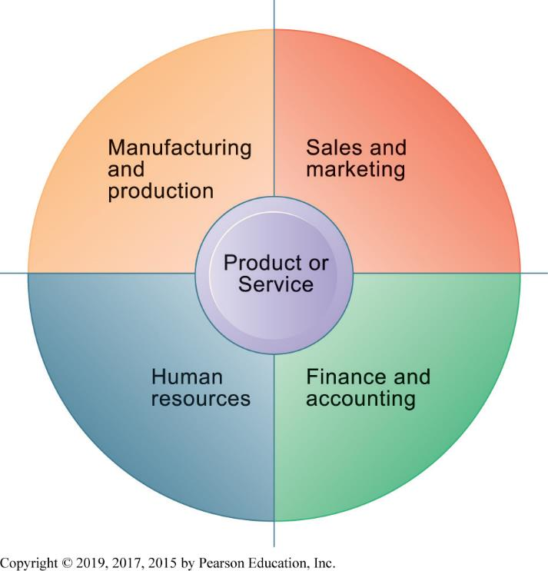
Figure 2.1 The Four Major Functions of a Business

Slide 6
2- Business Processes
Logically related set of tasks that define how specific business tasks are performed
The tasks each employee performs, in what order, and on what schedule
E.g., Steps in hiring an employee
Some processes tied to functional area
Sales and marketing: identifying customers
Some processes are cross-functional
Fulfilling customer order

Slide 7
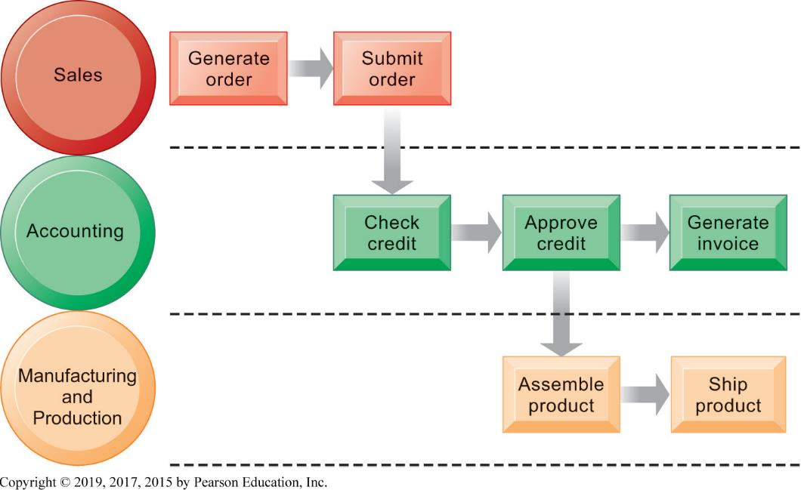
Figure 2.2 The Order Fulfillment Process

Slide 8
How I T Enhances Business Processes
Automation of manual processes
Change the flow of information
Replace sequential processes with simultaneous activity
Transform how a business works
Drive new business models

Slide 9
3-Managing a Business and Firm Hierarchies
Firms coordinate work of employees by developing hierarchy in which authority is concentrated at top.
Senior management
Middle management
Operational management
Knowledge workers
Data workers
Production or service workers
Each group has different needs for information.

Slide 10
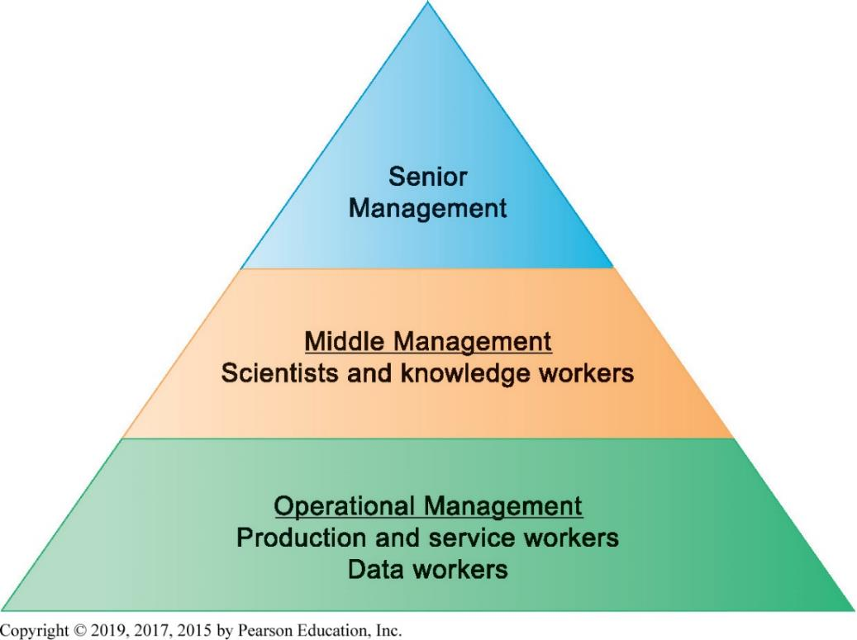
Figure 2.3 Levels in a Firm

Slide 11
4- The Business Environment
Businesses depend heavily on their environments for capital, labor, supplies, and more.
Global environment
Technology and science, economy, politics, international change
Immediate environment
Customers, suppliers, competitors, regulations, stockholders

Slide 12
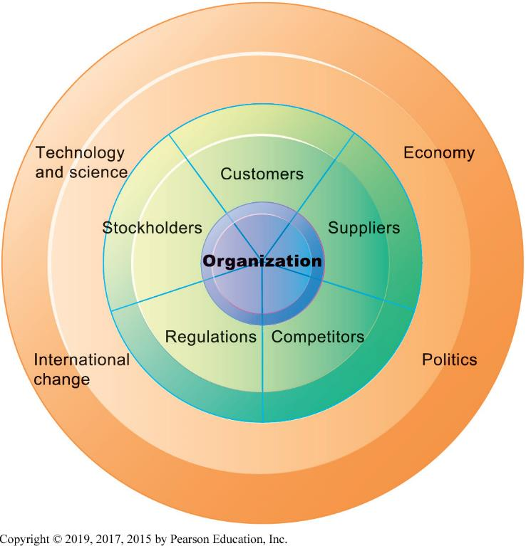
Figure 2.4 The Business Environment

Slide 13
5- The Role of Information Systems in a Business
Firms invest in information systems in order to:
Achieve operational excellence
Develop new products and services
Attain customer intimacy and service
Improve decision making
Promote competitive advantage
Ensure survival

Slide 14
Systems for Different Management Groups
Transaction processing systems (T P S)
Keep track of basic activities and transactions of organization
Systems for business intelligence
Address decision-making needs of all levels of management
Management information systems (M I S)
Decision support systems (D S S)
Executive support systems (E S S)

Slide 15
Transaction Processing Systems
Serve operational managers
Principal purpose is to answer routine questions and to track the flow of transactions through the organization
E.g., inventory questions, granting credit to customer
Monitor status of internal operations and firm’s relationship with external environment
Major producers of information for other systems
Highly central to business operations and functioning

Slide 16
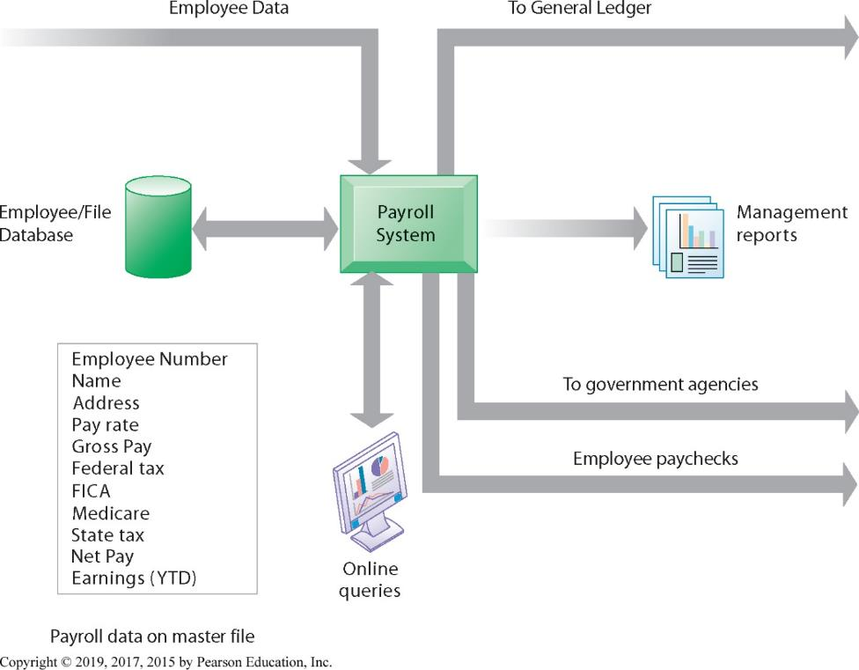
Figure 2.5 A Payroll T P S

Slide 17
Management Information Systems
Provide middle managers with reports on firm’s performance, to help monitor firm and predict future performance
Summarize and report on basic operations using data from T P S
Provide weekly, monthly, annual results, but may enable drilling down into daily or hourly data
Typically not very flexible systems with little analytic capability

Slide 18
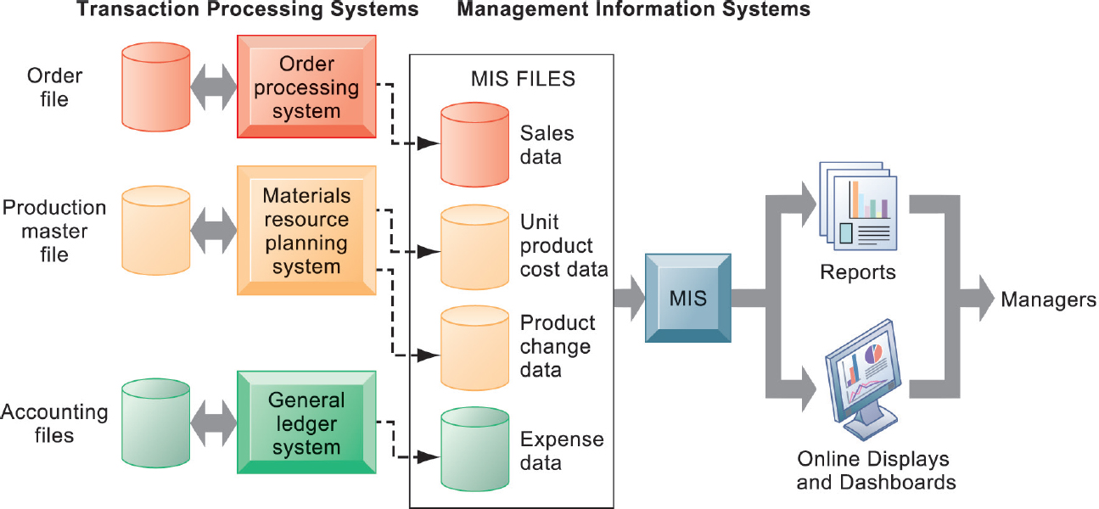
Figure 2.6 How M I S Obtain Their Data from the Organization’s T P S

Slide 19
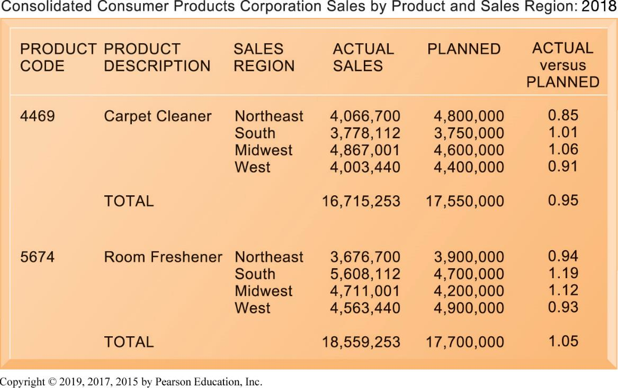
Figure 2.7 Sample M I S Report

Slide 20
Decision Support Systems
Serve middle managers
Support nonroutine decision making
Example: What is impact on production schedule if December sales doubled?
Often use external information as well from T P S and M I S
Data driven D S S
Intrawest’s marketing analysis systems

Slide 21
Executive Support Systems
Serve senior managers
Address strategic issues and long-term trends
E.g., what products should we make in five years?
Address nonroutine decision making
Provide generalized computing capacity that can be applied to changing array of problems
Draw summarized information from M I S, D S S, and data from external events
Typically use portal with Web interface, or digital dashboard, to present content

Slide 22
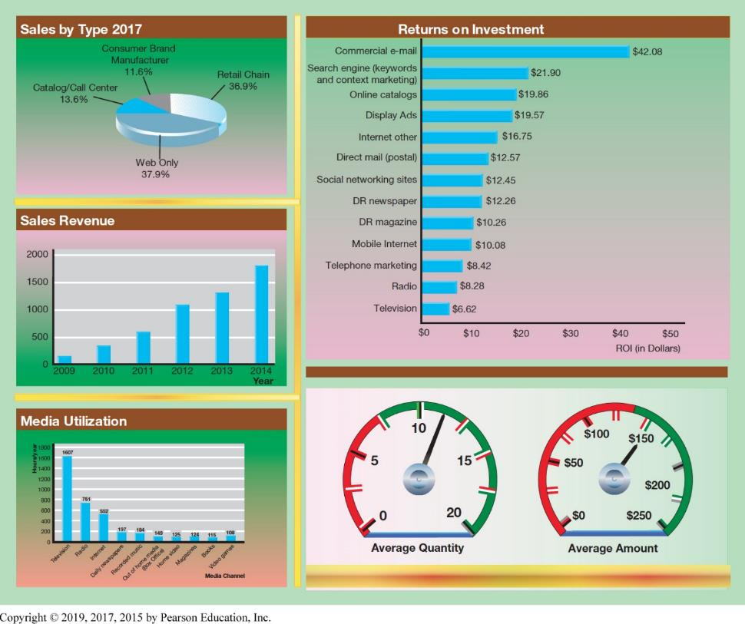
Figure Digital Dashboard

Slide 23
Type of System | Information Inputs | Information Outputs | Users
Transaction Processing Systems (TPS) | Transactions; daily events | Detailed reports; lists; summaries | Operations personnel; first-line supervisors
Management Information Systems (MIS) | Summary transaction data; high-volume data; simple models | Summary and exception reports | Middle managers
Decision Support Systems (DSS) | Optimized for data analysis, analytic models and data analysis tools. | Interactive; simulations; analysis | Professionals, staff managers
Executive Support Systems (ESS) | Aggregate data; external, internal | Projections; responses to queries | Senior managers

Slide 24
Systems for Linking the Enterprise
Enterprise applications
Systems that span functional areas, focus on executing business processes across the firm, and include all levels of management
Four major types
Enterprise systems
Supply chain management systems
Customer relationship management systems
Knowledge management systems

Slide 25
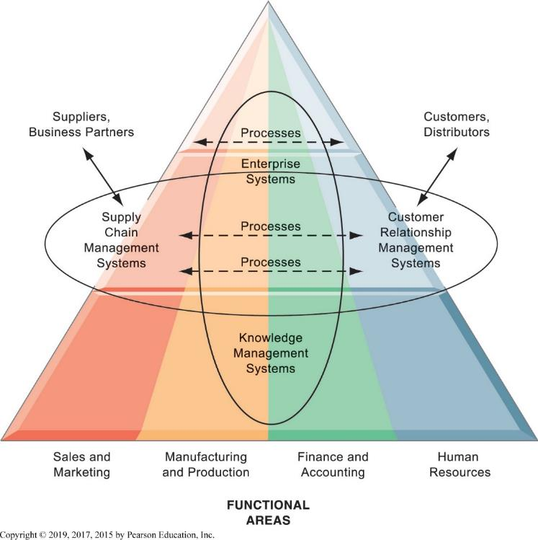
Figure 2.9 Enterprise Application Architecture

Slide 26
Enterprise Systems
Also called enterprise resource planning (E R P ) systems
Integrate data from key business processes into single system
Speed communication of information throughout firm
Enable greater flexibility in responding to customer requests, greater accuracy in order fulfilment
Enable managers to assemble overall view of operations

Slide 27
Supply Chain Management (S C M ) Systems
Manage relationships with suppliers, purchasing firms, distributors, and logistics companies
Manage shared information about orders, production, inventory levels, and so on
Goal is to move correct amount of product from source to point of consumption as quickly as possible and at lowest cost
Type of interorganizational system
Automating flow of information across organizational boundaries

Slide 28
Customer Relationship Management (C R M ) Systems
Help manage relationship with customers.
Coordinate business processes that deal with customers in sales, marketing, and customer service
Goals:
Optimize revenue
Improve customer satisfaction
Increase customer retention
Identify and retain most profitable customers
Increase sales

Slide 29
Knowledge Management Systems
Manage processes for capturing and applying knowledge and expertise
Collect relevant knowledge and make it available wherever needed in the enterprise to improve business processes and management decisions
Link firm to external sources of knowledge

Slide 30
Intranets and Extranets
Technology platforms that increase integration and expedite the flow of information
Intranets:
Internal networks based on Internet standards
Often are private access area in company’s website
Extranets:
Company websites accessible only to authorized vendors and suppliers
Facilitate collaboration

Slide 31
Management Decision Problems
2-8 Don’s Lumber Company: The prices of lumber and other building materials are constantly changing. When a customer asks about the price on pre-finished wood flooring, sales representatives consult a manual price sheet and then call the supplier for the most recent price. The supplier in turn uses a manual price sheet, which has been updated each day. Often the supplier must call back Don’s sales reps because the company does not have the newest pricing information immediately on hand. Assess the business impact of this situation, describe how this process could be improved with information technology, and identify the decisions that would have to be made to implement a solution. Who would make those decisions?

Slide 32
E-Business, E-Commerce, and E-Government
E-business:
Use of digital technology and Internet to drive major business processes
E-commerce:
Subset of e-business
Buying and selling goods and services through Internet
E-government:
Using Internet technology to deliver information and services to citizens, employees, and businesses

Slide 33
What is Collaboration?
Collaboration is working with others to achieve shared and explicit goals.
Growing importance of collaboration:
Changing nature of work
Changing organization of the firm
Changing scope of the firm
Emphasis on innovation
Changing culture of work and business

Slide 34
Video 1: IBM Social Business: How it Works: Greenwell
https://www.youtube.com/watch?v=nZEVCab_s3E

Slide 35
What is Social Business?
Use of social networking platforms to engage employees, customers, suppliers
Conversations to strengthen bonds
Requires information transparency
Seen as way to drive operational efficiency, spur innovation, accelerate decision making

Slide 36
Business Benefits of Collaboration and Social Business
Investment in collaboration technology can return large rewards, especially in sales and marketing, research and development
Productivity: Sharing knowledge and resolving problems
Quality: Faster resolution of quality issues
Innovation: More ideas for products and services
Financial performance: Generated by improvements in factors above

Slide 37
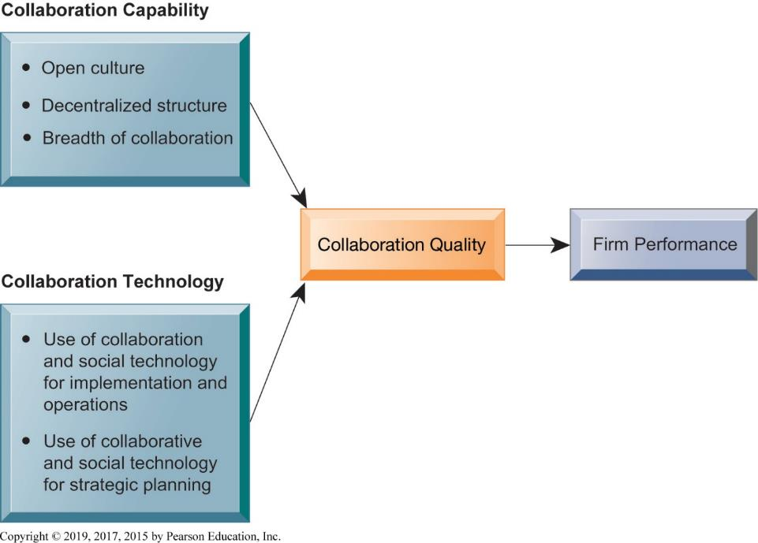
Figure 2.10 Requirements for Collaboration

Slide 38
Tools and Technologies for Collaboration and Teamwork
Email and instant messaging (I M )
Wikis
Virtual worlds
Collaboration and social business environments
Virtual meeting systems (telepresence)
Cloud collaboration services
Google Drive, Dropbox
Microsoft SharePoint and I B M Notes
Enterprise social networking tools

Slide 39
Video 2: CEMEX: Becoming a social business
https://www.youtube.com/watch?v=H7h4rUBsX3M

Slide 40
Evaluating and Selecting Collaboration Tools
What are your firm’s collaboration challenges?
What kinds of solutions are available?
Analyze available products’ cost and benefits.
Evaluate security risks.
Consult users for implementation and training issues.
Select candidate tools and evaluate vendors.

Slide 41
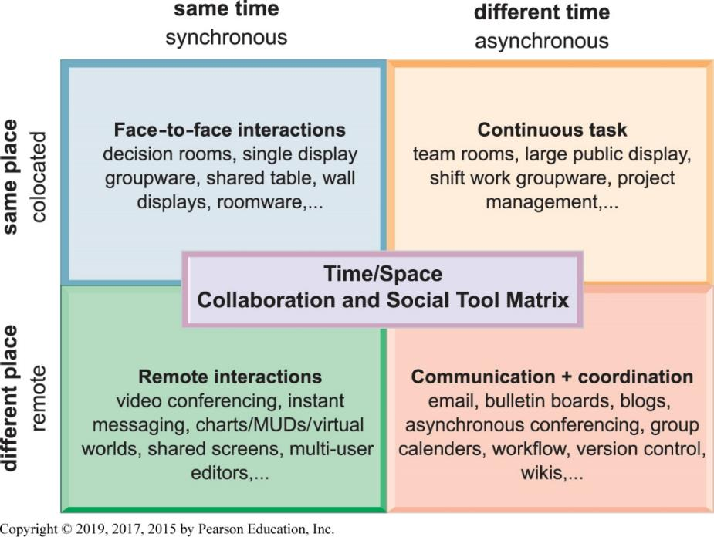
Figure 2.11 The Time/Space Collaboration and Social Tool Matrix

Slide 42
The Information Systems Department
Programmers
Systems analysts
Principle liaisons to rest of firm
Information systems managers
Leaders of teams of programmers and analysts, project managers, physical facility managers, telecommunications managers, database specialists, managers of computer operations, and data entry staff
Senior managers: C I O, C P O, C S O, C K O, C D O
End users

Slide 43
Information Systems Services
Computing services
Telecommunications services
Data management services
Application software services
Physical facilities management services
I T management services
I T standards services
I T educational services
I T research and development services

